Slide 1
Computer Principles for Programmers
IT Projects and Project Management
Notes:
Set up for video , Cat_Herders
https://www.youtube.com/watch?v=m_MaJDK3VNE
Building airplanes in the sky AKA iterative software development / DevOps
https://adland.tv/sites/default/files/videos/107291/17637/76436/hd_html5_mp4_1428313232.mp4

Slide 2
Agenda
Lecture:
What is “Project Management?”
What are some typical “IT Projects?”
What does a Project Manager do?
Project Management Process Groups: Initiation, Planning, Executing, Controlling, Closing.
Advantages of Project Management
What is Project Management Certification?
Notes:
Problems of academic group work:
PM is overhead, so it is done ad hoc if at all.
group project is split into separate silos with little communication
…it comes together an hour before it is due like two freight trains but in CPR101 you get paid for doing PM.
Social Loafing: you end up doing the lazy person's work.
but in CPR101, you can fire the lazy group member early in the PM plan, or we can discount their marks if they are lazy much later, both because of modularity in the project, and accountability in the PM plan, and tracking of effort in MS Teams.
We initiate the project, beginning anywhere.
We plan who, how, what, where, why, and when to do the project.
We do the work of the project.
We measure our progress versus project milestones.
Are we ahead or behind? We replan and rework as needed.
We deploy the project: examine lessons learned: what worked and what didn't.
We plan for future projects: what success to repeat, what troubles to avoid.

Slide 3

Some see the glass as half empty

Slide 4

Some see the glass as half full

Slide 5

Project Managers see the glass was too big
Notes:
Getting the amount of water and the size of the glass to fit is Project Management.

Slide 6
Final Project, 1st Deliverable: the plan
Project Planning:
Create your Team's private channel
Each team member uploads their notes on Project Management Process Groups to channel > Files
Each team member reviews other member's notes
The team develops a common understanding of Project Management Process Groups
Develop a S.M.A.R.T. plan for the whole project
Post the Plan.xlsx file in Team's private channel > Files

Slide 7
What is Project Management?
It's like herding cats or building airplanes
Notes:
https://www.youtube.com/watch?v=m_MaJDK3VNE
https://en.wikipedia.org/wiki/Cat_Herders
Building airplanes in the sky AKA iterative software development / DevOps
https://adland.tv/sites/default/files/videos/107291/17637/76436/hd_html5_mp4_1428313232.mp4
Working in ICT on production systems can feel like this:
https://www.youtube.com/watch?v=Str7m8xV7W8
The Montgomery Scott Guide To Project Management Skills
http://projectmanagementhacks.com/project-management-skills/

Slide 8
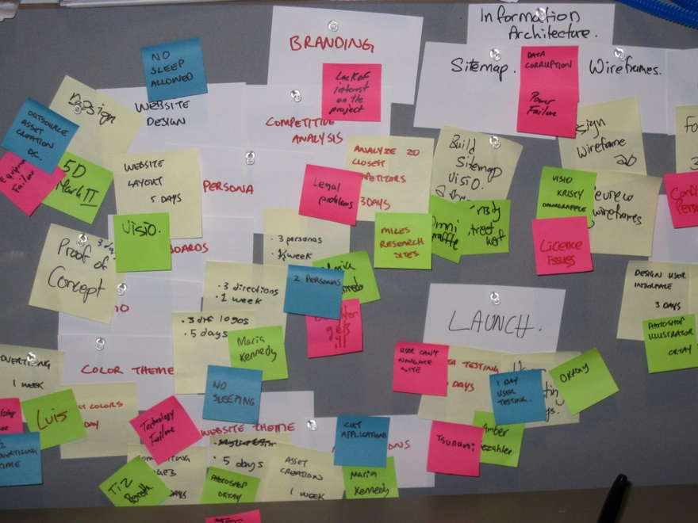
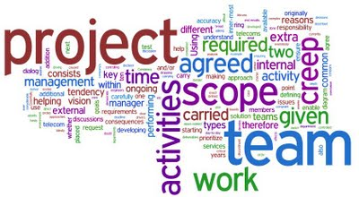
PROJECT
Business Systems Analysis – What's the problem?
System Development – What's the solution?
Project Management – Make it happen!
Notes:
Cost effective software delivered in a timely manner needs good analysis, good design, and good management. Why? If it costs $1 to identify a business requirement at the beginning of a project, it costs $100+ to add it after Going Live. The $1 cost is good management, the $100+ is bad management.
We had better know what we are doing. “good IT is expensive and bad IT is even more expensive” – Alex Beraskow
For every complex problem there is a solution which is clear, simple, and wrong." -- H L Mencken.
Peer's Law: The solution to the problem changes the problem.
Sevareid's law: The chief cause of problems is solutions.
example of a good project:
https://www.itworldcanada.com/article/sap-and-ibm-are-just-the-ticket-for-the-toronto-transit-commission/414648

Slide 9
What is Project Management?
…something employers want you to know!
Programming is just one aspect of creating a solution.
IT Project Mgmt is responsible for the whole solution.
"Project management is the application of knowledge, skills, tools and techniques to project activities to meet project requirements." -- Project Management Body of Knowledge (PMBOK) Guide from pmi.org
Notes:
The School of ICT has Industry Advisory Committees who advise us on what they want to see in our CPD & CPA graduates. Some of the technical skill sets change over time but they always ask that our graduates know about Project Management.
Project management is the application of knowledge, skills, tools and techniques to project activities to meet project requirements.
Project Management is the “discipline of initiating, planning, executing, controlling, and closing” the work of a team “to achieve specific goals and meet specific success criteria.”
Scope Management includes the processes required to ensure that the project includes all the work required, and only the work required, to complete the project successfully. Managing the project scope is primarily concerned with defining and controlling what is and is not included in the project.
https://blog.usejournal.com/information-is-the-key-to-excellence-in-software-engineering-teams-b40aa1c83ab0 Your people are your most important asset in any organisation. They need the tools to do their jobs to the best of their ability. And knowledge is the best tool you can arm them with.
They are on your team because, individually, they have the skills the project needs. A PM's job is to be in the service of their team, not to order them around. A PM's role is to provide them with good systems to access and share information so they can produce the best possible outcome. A PM's job is to facilitate communication within the team and between the team and the client's key users and business experts.

Slide 10
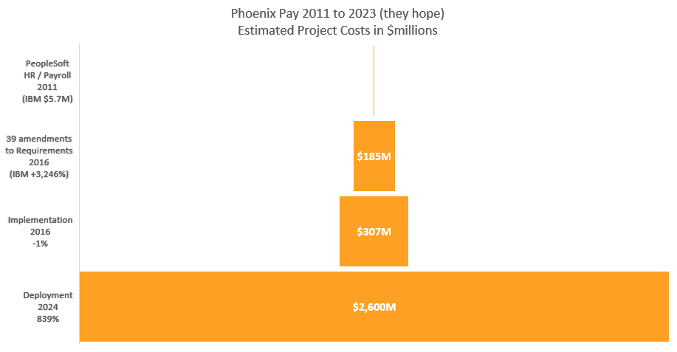
2009 $310M project budget will save $78M/year by 2015 Original IBM contract: $5.7M
290,000 employees, 34 HR/payroll systems, 101 departments, 105 contracts
200 custom modules needed for 80,000 pay rules
Scope: all 200 modules not implemented but "on time, under budget"
$2.6B estimated total costs
8.4 × original $310M budget
Phoenix Pay to be replaced.
Notes:
July 2009: federal gov/t approves funding for a $310-million Public Works project called Transformation of Pay Administration Initiative. Phoenix Pay was intended to replace Canada's 40-year old system with a new, cost-saving "automated, off-the-shelf commercial system" to serve "101 departments and nearly 300,000 employees". The objective: a new, more centralized and automated system would lower labour requirements and reduce costs by $78 million a year by "eliminating 650 positions, automating pay processes, and eliminating duplicate data entry." It was expected to be online by 2015. https://en.wikipedia.org/wiki/Phoenix_pay_system
310 / 78 = 4 year ROI (Return on Investment) which is good for a project of this size. $78M will be saved in each subsequent year of the system's life. A sensible justification to green light the project.
Not all modules were implemented for Go Live in April 2016 so that it could be "[close to] on time and under budget". Always easy if you ignore project's scope. IBM advised against going live at this time. 1,000 open bug reports by Jan.2017, 5 months after going live. (unclear whether the bugs were in existing software or whether they included missing functionality not yet implemented)
Issues: "Government managers have blamed the lack of training for employees, particularly those in the new Miramichi pay centre.[35] Federal unions have blamed IBM, drawing comparisons with the 2010 [Australian] Queensland Health payroll problems, which also involved IBM, and eventually cost $1.2 billion.[36] The former Conservative government has been blamed for cutting employees too quickly and under-spending on training.[37] The Liberal government has been blamed for rolling out the system too quickly and ignoring warning signs.[37]" https://en.wikipedia.org/wiki/Phoenix_pay_system
Audit of project found:
Failure to provide users with adequate training.
Failure to cleanse data prior to migration to the new system.
Software quality issues.
Failure to have sufficient resources on hand to address launch glitches and problems.
IBM Canada has stated: "The vast majority of the issues in this implementation are process and data issues, not technical system issues." [mostly true]
These are all project management issues.
https://www.cbc.ca/news/canada/ottawa/phoenix-payroll-problems-ibm-1.3770947
http://www.cbc.ca/news/canada/ottawa/phoenix-audit-missing-data-not-full-picture-1.4413112
https://www.theglobeandmail.com/news/politics/2018-federal-budget-highlights/article38116231/
http://www.cbc.ca/news/canada/ottawa/phoenix-eventually-replaced-federal-budget-2018-1.4554399
https://www.theglobeandmail.com/politics/article-three-public-servants-blamed-for-phoenix-pay-system-debacle-were-not/
By end of 2016, Phoenix caused pay problems to close to 80 percent of the federal government’s 290,000 public servants through underpayments, over-payments, and non-payments. On July 31, 2018, the Standing Senate Committee on National Finance submitted a report in which they called Phoenix a failure and an "international embarrassment". Instead of saving $70 million a year as planned, the report said that the cost to taxpayers to fix Phoenix's problems could be up to $2.2 billion by 2023. It "failed to properly pay nearly half of Canada's workforce of public servants, representing 153,000 people. The report added that the system had already cost taxpayers $954-million (3 times the revised revised project budget) and could rise to $2.2 to 2.6 billion by 2023 in unplanned costs. https://www.cbc.ca/news/canada/ottawa/phoenix-pay-system-cost-report-1.5138036
In May 2018, 600,000 issues and pay requests were unresolved at the Public Service Pay Centre – more than double the number of employees in the system. By Sept.2019, there were 228,000 outstanding transactions with financial impact affecting over half of all federal employees.
Outstanding transactions with financial impact over and above normal workload: overall downward trend since January 2018, from 384,000 to 200,000, as of November 23, 2022 but up from the low of 94,000 at March 2021. By late 2024, the backlog will likely have cleared. By then, Canada might know about the Pheonix Pay replacement system.
https://www.tpsgc-pwgsc.gc.ca/remuneration-compensation/services-paye-pay-services/centre-presse-media-centre/index-eng.html
Raw data from
https://www.tpsgc-pwgsc.gc.ca/remuneration-compensation/services-paye-pay-services/centre-presse-media-centre/mise-a-jour-update-eng.html
==> click the "review the Month 202Y dashboard"
https://www.canada.ca/en/treasury-board-secretariat/topics/pay.html
https://en.wikipedia.org/wiki/Phoenix_pay_system
http://www.theglobeandmail.com/report-on-business/rob-commentary/its-time-for-canada-to-invest-in-developing-artificial-intelligence/article34429736/
In February 2016, the Phoenix pay system was launched to over 34 government departments, affecting 120,000 employees.
In April 2016, despite initial problems, Phoenix launched the remaining 67 departments on April 21, 2016, and decommissioned the old system.
http://www.cbc.ca/news/canada/ottawa/phoenix-ibm-contract-union-pay-government-1.4295827
The relatively straightforward task of installing PeopleSoft HR software for a few government agencies morphed into a massive project dubbed Phoenix, which is detailed in a 1,700-page contract that has been revised some three dozen times, CBC reported at http://www.cbc.ca/news/canada/ottawa/phoenix-ibm-contract-union-pay-government-1.4295827
The IBM contract started at $5.7 million for the first stage of the deal with the Cdn federal gov't in 2011, i.e. install PeopleSoft HR package, but after 39 amendments over six years, the deal is worth $185 million. (scope creep!)
http://www.cbc.ca/news/canada/ottawa/phoenix-government-psac-payroll-1.4300801
https://www.itworldcanada.com/blog/phoenix-payroll-report-by-michael-wernick-the-clerk-of-the-privy-council/385370
http://thechronicleherald.ca/canada/1522576-a-by-the-numbers-look-at-the-auditor-generals-report-on-the-phoenix-pay-system
The implementation costs of a payroll system that was delayed and has never worked properly actually came in under budget at a cost of $307 million, the federal government says. That figure is $2 million less than what the government [re-]projected several years ago — but it doesn't include the multimillions earmarked for fixing Phoenix.
http://www.oag-bvg.gc.ca/internet/English/parl_oag_201711_01_e_42666.html
Complexity:
300,000 federal public servants were consolidated into a single payroll system
their pay, benefit plans and pension contributions are governed by 105 collective (union) agreements
administered by 34 HR/payroll systems.
80,000: Different pay rules that guide those payments.
200: Custom additions to Phoenix to handle those 80,000 rules.
Imagine the ETL from those dozens of payrolls systems to Extract, Translate, and Load the phoenix system.
Imagine the training necessary for users to be able to configure the 80,000 rules for each of 300,000 employees.
http://www.cbc.ca/news/canada/ottawa/phoenix-by-the-numbers-31-000-more-phoenix-cases-1.4425431 <– see infographic there.
http://calleam.com/WTPF/?tag=examples-of-failed-projects
http://calleam.com/WTPF/?p=8336
http://www.cbc.ca/news/canada/ottawa/phoenix-payroll-problems-ibm-1.3770947
https://www.cbc.ca/news/canada/ottawa/phoenix-pay-system-issues-impact-public-servants-six-years-later-1.6457840
Go Live was Feb 2016.
Many of the 300,000 public servants have been incorrectly paid. Some have received too little, some too much and some have received no pay at all…for MONTHS.
“you know your project is in trouble when … the Prime Minister has to address the issue”
There were more than 1,000 bug reports by January 2017
shortly after launch, as many as 7,000 calls per day were received by a help desk sized for 2,200 calls per day. By July 2016, there were 82,000 outstanding cases of errors affecting 1/4 of all public servants. Nearly two years post-implementation, officials have had to expand their payroll support staff from 550 heads to more than 1,500 to cope. Ironically, an initial justification for the project was to save on these support staff.
three Phoenix executives (senior civil servants) prioritized some aspects of the pay-system rollout, such as schedule and budget, over functionality. they also cancelled a pilot implementation project with one department that would have helped it detect problems indicating the system was not ready. “The building and implementation of Phoenix was an incomprehensible failure of project management and oversight,” auditor general Michael Ferguson in May, 2018 https://nationalpost.com/news/canada/newsalert-auditor-general-says-bureaucrats-bungled-phoenix-costing-millions
PHOENIX PAY SYSTEM
The federal government announced in the 2018 budget that it will eventually move away from its problem-plagued Phoenix pay system - which has overpaid, underpaid or completely failed to pay tens of thousands of public servants - and invest $16-million over two years to develop a new pay system.
In the meantime, Ottawa is planning to continue to invest in Phoenix for years to come. The 2018 budget proposes the government invest $431.4-million over six years to deal with ongoing issues in addition to the $227.6M previously budgeted for remediation. The money will help hire more staff at the Phoenix pay centre in Miramichi, N.B., and satellite offices across Canada, as well as additional payroll support staff in government departments.
http://brookfieldinstitute.ca/2017/03/22/10-things-canadas-innovators-entrepreneurs-should-know-budget/
http://business.financialpost.com/fp-tech-desk/federal-budget-2017-ottawa-aims-to-make-canada-digital-leader-with-ai-strategy-support-for-fintech-entrepreneurs
https://ipolitics.ca/2017/03/22/budget-outlines-plan-to-curb-canadas-innovation-headache/
https://www.cbc.ca/news/canada/ottawa/phoenix-cost-more-than-one-billion-dollars-1.4594115

Slide 11
Six Phases of a Project
Enthusiasm
Disillusionment
Panic
Search for the Guilty
Punishment of the Innocent
Praise and Honours for the Non-Participants
Notes:
This was the Phoenix Pay project.

Slide 12
Rules of Project Management
Every decision is easy…
Every job is easy…
Hofstadter's Law: It always takes longer than you expect, even when you take into account Hofstadter's Law.
The fix is to fall in love with their problem, not your solution.
Notes:
Every decision is easy… if you are not directly affected.
Every job is easy… if you are not the one doing the work.
"The first 90% of the code accounts for the first 90% of the development time. The remaining 10% of the code accounts for the other 90% of the development time." -- Tom Cargill, Bell Labs.
Hofstadter's Law: It always takes longer than you expect, even when you take into account Hofstadter's Law.
— Douglas Hofstadter, 'Gödel, Escher, Bach: An Eternal Golden Braid
https://xkcd.com/1658/ http://www.explainxkcd.com/wiki/index.php/1658 https://en.wikipedia.org/wiki/Hofstadter's_law
-------------------------------------
If you don't have time to do it right the first time, when are you going to find the time to fix it later?
"The future isn’t something to be predicted, it’s something to be achieved." Don Tapscott

Slide 13
What are some typical ICT Projects?”
Development of new software (25% of budgets) and enhancement of existing systems (75%)
Deployment of new software and user training across an organization. Old to new systems changeover.
Upgrading of workflows to move transactions, data, and processes from user to user
Upgrading of infrastructure: servers, network architecture, new PCs, OS updates to improve performance (not your job but it will affect you)
Notes:
75% of all software development dollars are spent maintaining existing programs to meet the future or catch up with the past:
Enhancing function
expanding interfaces (old COBOL banking back end to new smartphone front end)
changing processes—both technical and business side,
and a little bit on fixing bugs.

Slide 14
What does a Project Manager do?
PM ensures the project meets its goal, on time, within budget.
The goal is value and quality as a result of time, budget and scope.
A project is a “collaborative work, carefully planned, to achieve a particular task or goal.” …that’s the ideal…then you solve problems
Project Management Triangle or Triple Constraint
Scope = Time × Resources
Value Quality
Cost / Resource
Schedule / Time
Scope / Features
Notes:
Why are there project managers? There are many systems connections to be made and many relationships to be built within IT teams and between clients, key users, project sponsors, subject matter experts (SMEs), and testers. Also, because things go wrong.
However,
if you’re a hammer, everything looks like a nail. If you’ve identified yourself as a problem solver—if you view the world as a series of problems to be fixed—you’ll find problems even when they don’t exist.
What’s worse, when we jump into problem-solving mode, we focus on what isn’t working rather than what is working. We look for weaknesses instead of strengths. We focus on the negatives instead of the positives.
The remedy is simple.
Instead of only asking, What’s wrong and how do I fix it?, also ask, What’s working and how can I do more of it?
-- Ozan Verol https://ozanvarol.com/where-is-your-bright-spot/
A project management example:
Do you make your own coffee in the morning or do you get it on the run? If you DIY, the per cup cost is lower than a coffee shop but it requires an investment in resources such as a kettle or an espresso machine, also inventory management of raw materials. To improve quality, you grind your own beans, even roast your own beans. How much time do you spend making your own coffee and clean up afterwards vs prematurely aging in the Starblecks line up? What is the quality of your own coffee vs someone else's? how long does it stay hot? how easy is it to transport? what about the environmental impact of home vs away coffee?
The thing about coffee is that you have lots of experience getting, making, and drinking coffee. The thing with a software development project is that you've never done it before. If you had, it would not be a project; it would be "there's an app for that".
It is easy to bring any project in successfully without regard to one side of the triangle…if you can call that successful.
The thing is, "Crappiness takes a while to detect while lateness is apparent immediately." from JOHO - Hyperlinked Organization - Home Page (David Weinberger) (hyperorg.com)
On time (budgeted work hours and scheduled calendar delivery) & on budget (cost & resources) is easy without regard to Scope & Quality (it may or may not be complete, it may or may not work).
Increased Scope (called Scope Creep or Feature Creep) can be handled with at least one of unlimited resources and/or unlimited time.
Budget cuts are handled with more time or less scope.
Accelerated schedules are handled with more resource (usually known as evenings and weekends) or less scope (usually unknown as in “What do you mean less scope? We have to have it all and more!”).
Project Managers exist to solve problems. If everything went according to that careful plan, they would be called Project Planners. Project Managers have jobs not because things go wrong, but because reliable predictions about the future are always somewhat inaccurate.
Brook’s Law was coined by Fred Brooks in his 1975 book The Mythical Man-Month. A copy is in the Seneca library.
The law: "adding manpower to a late software project makes it later".
Ramp up time. Bring a new person up to speed slows down the others.
Communication is an n-squared problem. Adding people requires more information channels to be developed between other people, other groups, and within a team's sub-groups.
Limited divisibility of tasks: Why can’t you just get 9 women and make a baby in one month?
Web search: Project Management Triangle (AKA Triple Constraint, Iron Triangle)
http://dilbert.com/search_results?terms=project
http://dilbert.com/search_results?terms=project+management
http://dilbert.com/search_results?terms=Future
http://dilbert.com/search_results?terms=scope
http://dilbert.com/search_results?page=2&terms=schedule
http://dilbert.com/search_results?terms=add+people
Image from https://programsuccess.wordpress.com/2011/05/02/scope-time-and-cost-managing-the-triple-constraint/

Slide 15
What does a Project Manager know?
general knowledge of management, human communication, and collaboration.
a lot about at least one aspect of the project, and a little about everything.
general knowledge of the project’s discipline
you can’t manage an IT project unless you understand IT, how it fits a business, and the process – good and bad – of development
enough to judge whether a developer’s estimate is naively overoptimistic or is lazy sandbagging.
Notes:
This Amish fellow, call him Abner, looked me [Howard Rheingold] in the eye and said: "We don't stop with asking what a tool does. We ask about what kind of people we become when we use it."
--
Managers are people who think they can wish things into existence.
--
The total project is composed of its Scope (features), Resources (to satisfy the Scope), and Time (to complete the Scope). The three are interdependent.
Scope = the work the project is supposed to accomplish, the features, the quality. This is usually different from the formal deliverables and requirements as the mental models of the Scope held by the Customer, Project Manager, and Systems Development staff are often different. The SDLC often isolates the developers from the Customer especially when the project is outsourced. Thus there may be no check or balance on the Project Manager's (and his or her boss's) interpretations and explanations.
Resources = the people (both Customer and Developer), software, hardware, and money needed to develop and deliver the Scope. They represent the craftsmanship to be revealed in the final product.
Time = the number of calendar days and person hours needed to develop and deliver the Scope by a Go Live date.
The usual problem in must projects when underway is Scope creep. Business and System requirements emerge as the project develops. This is more a fact of life than a deficiency in the process. Let's say 70% of the Scope is defined at the onset. Some consider this to be as good as it gets.
Resources are often composed mostly of Developers. It should also have Customer staff, but the Customer does not have enough staff, that's why they need the system in the first place. Developers are asked how long it will take them to do something they have never done before. Let's say estimating what it will take and the technology to solve the problems are known to a 70% degree of certainty.
The predicted delivery time is a function of Scope and Resources. If the Scope and Resource probabilities of success are 0.7, then the probability of hitting the Time target is 0.49 (0.7 X 0.7). The project has less than even odds of failure and it hasn't even started yet.
Most projects end up being calendar deficient. The hours of work required and the calendar available to do it in often come into conflict. People work overtime to make up the calendar deficiency. People get tired. They sacrifice sleep and thereby, IQ points. They make mistakes. More hours are needed. Less hours are available. The people try even harder. Projects delivered on time are crappy which can take some time to become apparent in which case it will be too late to do anything except live with the crap; projects that are late (immediately noticeable) have a chance of working.
Projects are often late before they begin because of the long sell cycle and the time it takes to properly define the requirements and deliverables. Nevertheless, the Go Live date, e.g. Jan. 1, 2000 for the Y2K project, cannot be changed.
The Customer is paying the Developers to do the job, has told them what needs to be done, and doesn't have any more time to devote to the project until training begins. After all, if they had lots of people and time, they wouldn't need the system in the first place.
Programmers:
- keep them happy so they code like crazy
- make them stop otherwise they will never be finished -- they're programmers, they like to code.
- their estimates are just that, estimates – not budgets. PMs ask them how long it will take to do something they've never done before! Of course their answer will be unreliable. "We can do this job in a few days." "We can't complete that until month after next." PMs need a reliable bullshit detector to judge whether developers are naively overoptimistic or lazy sandbaggers.
Customers:
- they want the functionality delivered for a new system they cannot completely imagine. They are not psychics, and neither are systems architects. It is rather difficult to envision a new system in one's head without a universe sized brain space like Nikola Tesla or John von Neumann. Of course our specs will be incomplete.
- set expectations low, deliver in modular chunks otherwise they'll wait for the perfect system. Just like programmers, they want their baby to be perfect. Perfection proceeds from one realized step to the next dream, then repeats and so never stops. Perfection is the enemy of the good.
Escalating requirements are otherwise known as scope creep. It's often thought of as people hanging more and more things on the Christmas tree. Scope creep happens more like quantum leaps. Creativity jumps to a new level upon realization of a project's specified requirements; when a requirement is implemented and can be seen and tested, it generates new ideas. It's a wonderful, intoxicating process that human beings are very, very good at. Bringing it into reality in bite sized, installable, useful steps is the key to Agile development. The universe didn't start out perfect. The universe is a hack. The perfect monolithic system is vanity (and the Waterfall method). Although, it is found in Genesis. If God could create the world in 6 days, what's taking you so long?
Coping with increased scope within the same calendar time frame naturally needs more resources. A lot more resources. This only works until the effort consumed by the interactions between all the resources exceeds the work being accomplished. That is, it's Brooks' Law: “Adding manpower to a late software project makes it later.” Thirty years later, in 2005, Brooks said, “everybody quotes it, some people read it, and a few people follow it.” baby
Project Managers who can get agreement from the stakeholders in prioritizing quality (Scope), costs (Resources), and timeliness are able to make a success of projects whether or not they make budget and/or time targets. Instead of On Time and On Budget, PM and customer agree on what value looks like (also part of Agile methodology). This comes back to Scope, Time/Schedule, Resources … pick two.
The most successful systems have been small systems. Big systems made up of many small systems with a common means of inter-communication also tend to work. Like the Internet. It's a big thing made up of many, many small things that, each one on its own, are just like the big thing.

Slide 16
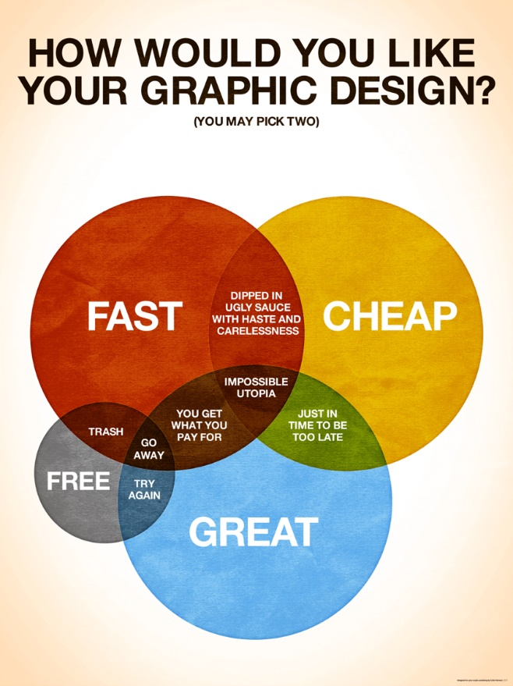
Good Cheap Fast
Pick Two
Notes:
Good – Cheap – Fast are like Scope – Resources – Time in the PM Triangle or triple constraint. All three at the same time are difficult to achieve.
PMs have a problem: Computer hardware has steadily become better, faster, and cheaper for over 60 years. So have telecommunications. Compare your first PC with, if you are old enough, an analog modem card to the machine you have now with a built in 1Gb network port. Moore’s Law: computing power of Integrated Circuits doubles every ~18 months at no increase in cost per IC.
The only exception this has been Apple. There is never a cheap option. In fact, an iPhone continues to get relatively more and more expensive.
Looking backward at hardware development sets expectations when looking forward to software development. But software does not obey Moore's Law. Software is made by people and people have not become many orders of magnitude faster, better, or cheaper in the last 7 decades. There is no economy of scale when creating software as there is when producing microchips. Yes, software tools continue to get better thanks to the pioneering work by the women known as the ENIAC 6 (who invented binary trees, sorting, breakpoints for debugging, and the foundational concepts for programming languages and compilers). But software cannot meet the same expectations clients have come to expect from their hardware. Microchips are made from silicon; software applications are made from ideas.
https://ee.stanford.edu/~hellman/opinion/moore.html
$1 of computational power available from Amazon Web Services today gets you 385 MFLOPS or the power of 769,840 ENIACs in 1946. see https://www.theregister.co.uk/2019/06/20/supercomputer_aws/
Today, ENIAC's same computational power is used in greeting cards that play you a tune. Imagine the reaction if Time magazine, in its cover story about the ENIAC (worth $5.3M in 2019 dollars), had predicted: seventy years in the future, millions of hand-held, self-powered ENIACs will be bought for a few dollars at the corner store, used for 30 seconds and thrown away. No one would have believed you.
The 1946 ENIAC occupied 1,800 square feet and weighed more than 25 tons; it could execute 5,000 addition/subtraction/multiplication instructions per second or 500 FLOPS (floating point operations per second) for division. The iPhone 11 is 80cm-square and weighs 194g; its A13 Bionic processor does 155 billion instructions per second.
The slowest of today's 500 supercomputers crunches a petaFLOP—or 1,000,000 GFLPOS. https://www.top500.org/news/top500-becomes-a-petaflop-club-for-supercomputers/ https://pages.experts-exchange.com/processing-power-compared
https://aiimpacts.org/trends-in-the-cost-of-computing/ (about 12 orders of magnitude difference between 1946 and 2007, i.e. a trillion) estimate FLOPS grow by an order of magnitude every 7.7 years or 1 FLOP in 1946 = 9.35B in 2018
http://blogs.luc.edu/itshelpdesk/2013/02/07/the-history-of-processing-power/
http://money.cnn.com/interactive/technology/computing-power-timeline/
https://www.popsci.com/supercomputers-then-and-now http://allthatsinteresting.com/first-computer
https://technical.ly/philly/2011/02/15/eniac-10-things-you-should-know-about-the-original-modern-super-computer-65-years-later/ https://www.huffingtonpost.ca/entry/watson-scientific-computing-lab_n_2592670
Graphic from www.colinharman.com
Animated gif from http://missingcloud.com/gif/GoodCheapFast_MissingCloud_.gif
https://www.business.com/articles/fast-good-cheap-pick-three/
https://berkonomics.com/?p=2437

Slide 17
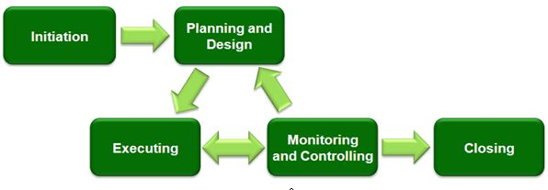
Project Management Process Groups
Notes:
https://www.linkedin.com/pulse/20140611182435-12732154-5-steps-to-a-successful-implementation-of-ict-projects
These processes can occur multiple times within a project: at each major phase/stage or sub-project
Initiation
Project Level:
Sponsor defines project objectives, agrees to scope, and grants authority to the project manager.
The sponsor is the client, customer, senior management of the company.
Sub-Project or Phase/Stage Level:
Project Manager decides order of sub-projects/phases, aligns resources and stakeholders.
The sponsor/acceptor can be the client’s Business Analyst, Division Director, or Dept. manager depending on scope of work.
Planning
Project Manager determines scope, work breakdown structure.
A work breakdown structure is a key project deliverable that organizes the team's work into manageable sections.
https://en.wikipedia.org/wiki/Work_breakdown_structure
Executing
Puts the project plan into motion and performs the work of the project.
Controlling
Measures the performance of the executing activities and compares the results with the project plan.
Note these middle three processes are iterative. This is where a PM’s skills at problem solving and leadership are heavily used.
Closing
Documents the formal acceptance of the product at this phase and brings all aspects of the phase to a close.
Lessons Learned are documented: how to repeat success, how to avoid failures.

Slide 18
SMART objectives
SMART objectives complete a project's goals
Everyone knows what they will do in each Process Group
Specific Measurable
Agreed on
Realistic
Time based
Notes:
This is a business standard for managing a team. It is how people know what is expected.
It is your checklist to know how Specific objectives will be Measured for acceptability by the team, and which are Realistically achievable before you Agree to deliver on Time.
Each person is their own project manager…
TO DO: Specific objectives and tasks which were Agreed upon
DOING: work in progress: an objective or task according to a Time based target – hours of effort will be completed by a due date & time
TESTING: work promoted by team member after Doing to other team members for Testing/Measurement.
DONE: an objective or task Tested/Measured as completed. Only Team leader can change status to DONE (or back to DOING for rework or HUNG UP for problem resolution)
HUNG UP: no longer doing something because it became unRealistic. Tell the team right away. E.g. hours required will not be completed by the due date-time; it was realized when Doing that objectives were too vague; insufficient metrics to test and measure doneness.
See Final Assignment Plan.docx
https://en.wikipedia.org/wiki/SMART_criteria

Slide 19
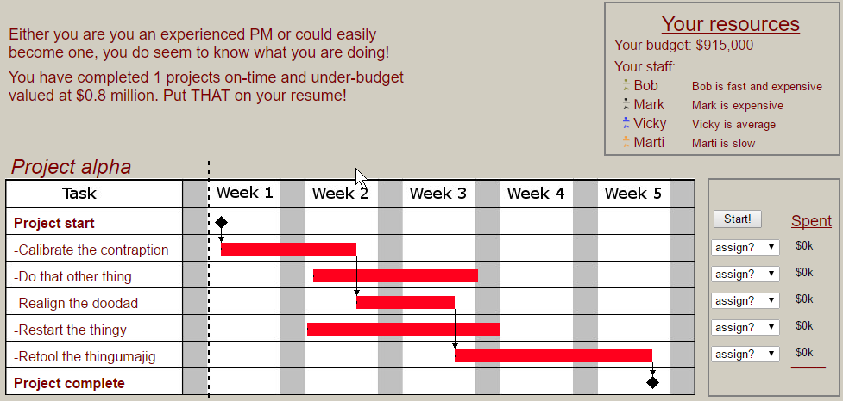
PM test at http://thatpmgame.com/
Notes:
Scope – Time – Resources in the PM Triangle or triple constraint.
http://thatpmgame.com/
Plan by putting available resources on the Gantt chart to complete tasks on time and on budget.
This
chart shows what tasks are prerequisites to the start of next tasks, i.e. schedule dependencies.
More on WBS and Gantt charts in the Notes slides below.

Slide 20

Advantages of Project Management & Project Management Certification

Slide 21
Advantages of Project Management
Better control of financial, physical, and human resources
Shorter development times
Better internal coordination
Lower overall costs
Improved productivity
Higher worker morale
Higher customer satisfaction
Project Management is the fastest growing job category today!

Slide 22
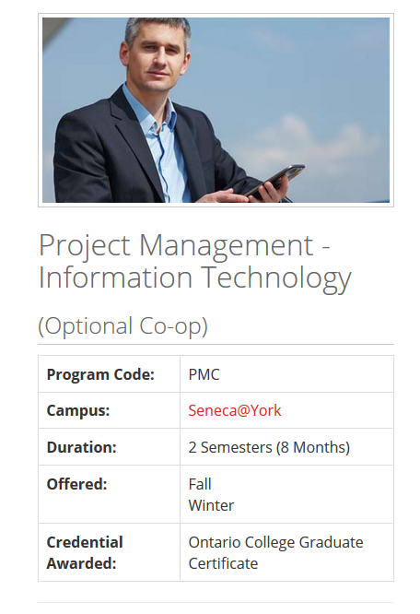



PM and more at Seneca College
Full and part-time graduate certificates in FinTech and Security. Certification & Professional Development Courses
Notes:
URLs linked to images including Seneca Downtown.
https://www.senecacollege.ca/programs/fulltime/PMC.html
https://www.senecacollege.ca/ce/business/management-human-resources/advanced-project-management.html
https://www.senecacollege.ca/ce/business/management-human-resources/business-analysis.html

Slide 23
Notes
What follows may be useful in planning the Final Project

Slide 24
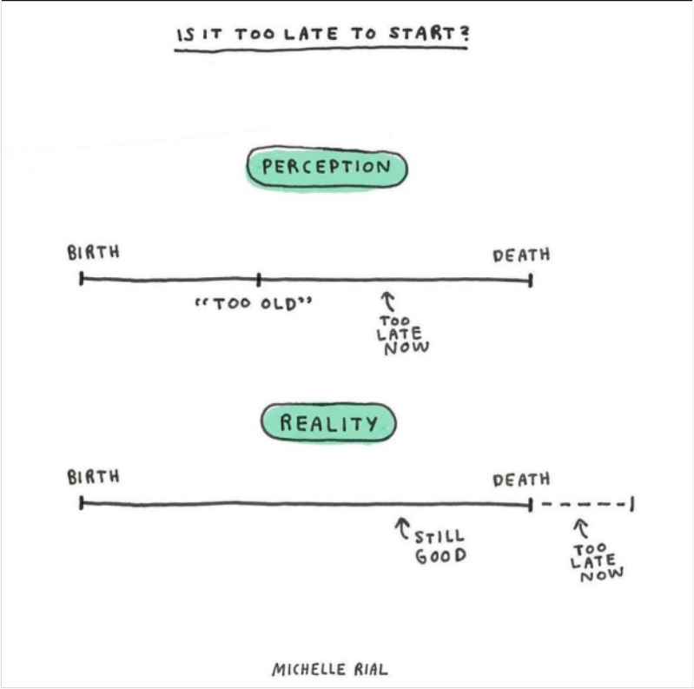
Is it too late to start?

Slide 25
PM Process Groups
“artefacts” -- things created by PM and SDLC. from Latin arte ‘by or using art’ + factum ‘something made’.
Initiation: See the specifications.
Planning
➔ What does this mean to you with respect to producing the artefacts for the Final Project?
➔ How will you and your group know what is needed, and what is to be done?
Executing
➔ What does this mean to you with respect to producing the artefacts for the Final Project?
➔ How will you and your group create the project artefacts? e.g. Is everyone clear about the scope of their individual tasks? Will the right tools, materials, and resources be available at the right time?
Controlling
➔ What does this mean to you with respect to producing the artefacts for the Final Project?
➔ How will you and your group ensure tasks are completed as planned?
Closing
➔ What does this mean to you with respect to producing the artefacts for the Final Project?
➔ How will you and your group confirm you have completed the project on time with the expected quality?

Slide 26

Initiation
Initiation
Typically a company has a problem and defines a plan to solve the problem which is approved by management.
The Plan is a very “high-level” plan which defines the objectives to be achieved.
And typically grants authority to hire a Project Manager (PM)

Slide 27

Planning
Project Scope: work to be delivered which will support business objectives, goals, and benefits.
The Project Manager (PM)
defines project parameters through consultation with stakeholders. typically: Senior Management, Key & End Users, Technical Staff
ensures the project's objectives – delivery of scope – are realistic, achievable, and deliverable.
details the project scope so all stakeholders fully understand the work to be done (and not done).
estimates project costs, sets delivery schedule, defines value.
Notes:
https://en.wikipedia.org/wiki/Scope_(project_management)
Correctly defining the Scope leads to:
Ability to break the work done into concrete steps.
Understand the total cost of the project.
Tender contracts to complete the project.
Assign responsibility for key components.

Slide 28
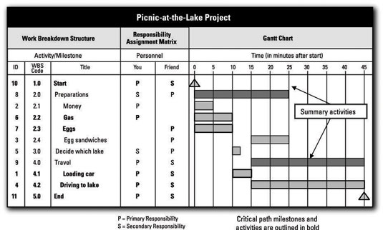
Planning – Work Breakdown Schedule (WBS)
WBS breaks Scope into tasks (details of what must be done, not how) with estimated hours and needed skill levels.
A Gantt Chart gives the overall timeline for work-packages to be assigned to people or technical roles.
Notes:
http://www.dummies.com/careers/project-management/4-ways-to-display-your-projects-schedule/#slide-3
https://en.wikipedia.org/wiki/Work_breakdown_structure
A WBS is not an exhaustive list of work. It is instead a comprehensive classification of project scope.
A WBS is neither a project plan, a schedule, nor a chronological listing. It specifies what will be done, not necessarily how or when. That said, budgets, and estimates, hours per WBS item and related labour rates are also needed.
Gantt charts and Critical Paths address who, how, and when tasks are completed.
General rule of WBS tasks is the 8/80 rule. A task's work can be accomplished in 8 hours and not more than 80 hours or 1 day to two weeks.
A work package at the activity level is a task that:
can be realistically and confidently estimated;
makes no sense practically to break down any further – the task description is enough for an expert to understand;
produces a deliverable which is measurable; and
forms a unique package of work which can be assigned to a known person, a technical role, outsourced, or contracted out. A skilled person could go away and complete the work package.
Tasks are acquisition of hardware, creation of software, and deployment/installation activities; these are all measurable deliverables.
A person-month is 120 – 150 hours, that is billable or task productive hours. It takes into account statutory holidays and administrative time.
https://en.wikipedia.org/wiki/Gantt_chart
A Gantt chart should also show what tasks are prerequisites to the start of next tasks, i.e. schedule dependencies.
A similar technique is using the Critical Path Method to construct a model of the project that includes the following:
A list of all activities required to complete the project (typically categorized within a work breakdown structure),
The time (duration) that each activity will take to complete,
The dependencies between the activities and,
Logical end points such as milestones or deliverable items.
This gives greater granularity in scheduling overlapping non-dependent activities, which set of dependent activities require the longest timelines, and where the schedule might be "crashed" by shifting more resources towards the completion of an activity.
https://en.wikipedia.org/wiki/Critical_path_method

Slide 29
Planning – Budget of estimated costs
Equipment description | units | $/unit | Estimate
Component A (details & configuration) | 1 | 9,234.50 | 9,234.50
Component B (details & configuration) | 79 | 987.65 | 78,024.35
Component C (details & configuration) | 83 | 345.67 | 28,690.61
Equipment total |  |  | 115,949.46
Services description | hours | $/hour | Estimate
WBS task category 1 | 87.5 | 99.00 | 8,662.50
WBS task category 2 | 190.0 | 24.00 | 4,560.00
WBS task category 3 | 63 | 150.00 | 9,450.00
Services total |  |  | 22,672.50
Notes:
WBS estimates detailed tasks, estimated hours @ skill level.
General categories of tasks by skill level are summarized for the budget.
Budget applies hourly cost of a skill level to estimated hours.

Slide 30

Executing
Starts after client approval and team agreement of the project plan for cost/resources, schedule/time, scope/quality.
PM coordinates with client for time and space, allocates resources, sources equipment, assigns tasks from WBS, communicates between and within stakeholder groups.
PM performs quality assurance on project phases, ensures task completion with quality control.

Slide 31

Monitoring and Controlling
Project Manager continually measures the performance (cost/resources, schedule/time, scope/quality) of all activities and compares the results with the project plan. PM is responsible for delivering value to the client.
How to identify problems quickly and take corrective action?
Monitoring task progress:
Where are we now?
Monitoring variables:
Plan vs Actual (timeline)
Budget vs Actual (costs)
Where should we be now?
Identifying corrective actions:
How can we get back on track?

Slide 32
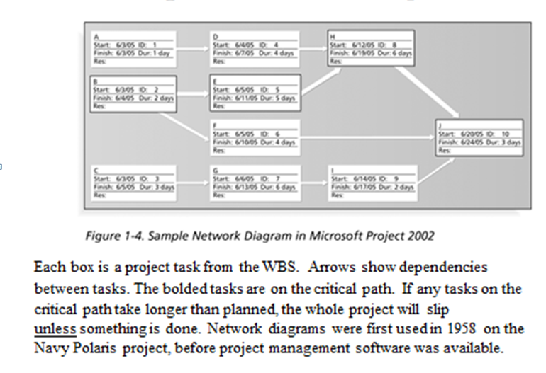
Controlling (Cont’d)
Today, mostly Software is used to control projects.
There is specialized software for small, medium and large projects.
The software here shows the “critical path.”
Notes:
http://www.dummies.com/software/microsoft-office/project/10-golden-rules-project-management/

Slide 33

Closing
Documents the formal acceptance of the project’s product and brings all aspects of the project to a close.
Closing includes the formal acceptance of the project and the ending thereof. Administrative activities include the archiving of the files and documenting lessons learned.
This process group consists of:
Contract closure: Complete and settle each contract (including the resolution of any open items) and close each contract applicable to the project or project's phase/stage.
Project closure: Finalize all activities across all of the process groups to formally close the project or project's phase/stage.
Post Implementation Review: This is a vital phase of the project for the project team to learn from experiences and apply to future projects. Normally a Post Implementation Review consists of looking at things that went well and analyzing things that went badly on the project to come up with lessons learned.

Slide 34
Project Manager Professional (PMP)
Project Management is a profession and project managers must follow a Code of Ethics.
Project Management Institute provides training and certification. (www.pmi.org)
Seneca College is a registered education provider (R.E.P) of PMI.
Notes:
In order to gain PMP certification you must pass the exams and agree to the code of ethics.
The number of people adding PMP to their resume is increasing quickly. Consider adding it to yours.

Slide 35
Why there is a need for Project Management?
Project Scope: "The work that needs to be accomplished to deliver a product, service, or result with the specified features and functions."
Top 5 Reasons for Project Management http://sambit-daspatnaik.blogspot.ca/2012/10/top-5-reasons-why-we-need-project.html:
deliver within scope, on time, within budget
deliver with quality
ensure productivity
prevent re-work
avoid blame gaming
Notes:
https://en.wikipedia.org/wiki/Scope_(project_management)
Using sound project management techniques and processes will give you a higher likelihood that your project will be completed on time, within budget and to an acceptable level of quality.
1. Are you going to manage scope or deal with cost and deadline overruns caused by doing more work than your budget covers?
A project's Scope statement defines and controls what is and, potentially, what is not included in the project.
2. Are you going to build quality into your process or fix problems later when they will be more costly to resolve?
3. Are you going to communicate proactively or deal with conflict and uncertainty caused by a lack of project information?
4. Your project will face potential risks. Do you want to try to resolve them before they happen or wait until the problems arise?
5. Your project is going to face issues. Do you want to proactively resolve them or figure them out as you go?
http://www.tensteppm.com/open/A1ValueofPM.html
Top 5 Reasons why we need Project Management Processes
We all follow Project Management processes in our projects. Mostly, they are tailored to meet the requirements of the project. Some projects need tighter control and more stringent processes that might have been mandated in the contract, while some need processes sufficient to self manage and execute the project to meet the deadlines and quality standards. Whatever be the reasons, if we don’t follow certain processes, it will definitely jeopardize the project.
Here are top 5 reasons why we need to follow processes:
1) To meet the deadlines: This is first and foremost. Many times, there are delays in deploying the project at the client’s site because there is no process defined for uploading the software or patches in the customer’s environment. Important steps like build packaging, testing the smooth installation are left out if these are not mentioned in a standard to do checklist. This can cause the team to run around for last minute activities that may result in more problems identified at the last minute. This inadvertently delays the final delivery of the project or product to the customer.
2) To maintain the right quality: If certain processes or tasks are missed, a high number of defects will be raised at the customer end. Some of them can be precarious such as an interactive website not opening at all for the end user (Obamacare launch), or payments being incorrectly processed (Target Canada).
3) To ensure productivity: If processes are not maintained and followed, it can result in tasks or activities being identified in an ad hoc manner with managers expecting team to stay late and complete work that could have been otherwise planned well in advance. The team will eventually burn out.
4) To prevent re-work: It costs $1 to create a business requirement, it costs $100+ to add it after Go Live.
Many a times, due to lack of process, the communication between team members and managers is less than adequate. Assumptions are made. Tasks are completed with a different set of objectives in mind. E.g., Software developer ending up writing code that result in performance issues in a mission critical product. This can cause the customer to wait for a long time for say, a financial transaction to happen. The team then ends up fixing the problem in the next build or release cycle causing more re-work.
5) To avoid blame gaming: All the above points lead to one major effect….Playing the blame game. Each team puts the blame to the previous team, or puts the blame of bad quality to production team. And this goes on in a vicious circle. Add political angle to it, and the project goes for a six. While all this could have been easily avoided by simply following right processes.
Japanese maxim: Fix the problem, not the blame.
(http://sambit-daspatnaik.blogspot.ca/2012/10/top-5-reasons-why-we-need-project.html)
https://en.wikipedia.org/wiki/Project_management
https://www.wrike.com/project-management-guide/methodologies/

Slide 36
Failure to define the project scope and taking into account all stakeholders, can lead to miss-defining the project and failure to complete the project
www.pmi.org web site PMBOK Guide

Slide 37
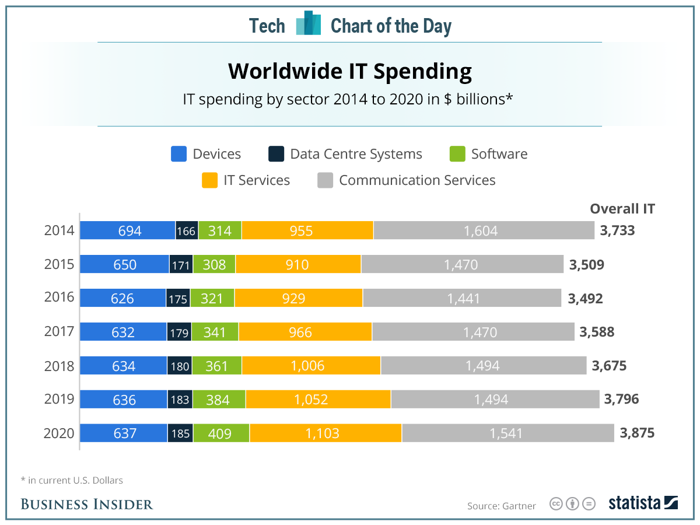
Worldwide IT Spending
Garnter Inc.
Notes:
https://www.gartner.com/en/newsroom/press-releases/2021-10-20-gartner-forecasts-worldwide-it-spending-to-exceed-4-trillion-in-2022
---------
Worldwide IT spending is projected to total $3.5 trillion in 2017, a 2.7 percent increase from 2016, according to Gartner, Inc. The worldwide IT services market is forecast to grow 4.2 percent in 2017. Buyer investments in digital business, intelligent automation, and services optimization and innovation continue to drive growth in the market. http://www.gartner.com/newsroom/id/3568917
The largest region for total IT spend in 2017 remains North America, with USD$1.19 trillion. However, the fastest-growing region is emerging Asia/Pacific, with 2017 constant-currency growth of 5.9% (revised up 0.4% from the 3Q16 update). The next-best region for growth is sub-Saharan Africa, with 2017 constant-currency growth of 5.2%, up 0.5% from 3Q16.
USD$3.464 trillion world-wide spending USD$900B in IT Services and USD$333B in Enterprise Software. Those last two areas are us in CPD/CPA. They are also the areas showing the strongest growth in the last few years historically and projected.
Seneca Library has access to the Gartner database. http://library.senecacollege.ca/res/Gartner.html
We had better know what we are doing. “good IT is expensive and bad IT is even more expensive”
http://calleam.com/WTPF/?tag=examples-of-failed-projects
http://calleam.com/WTPF/?p=8336
http://www.cbc.ca/news/canada/ottawa/phoenix-payroll-problems-ibm-1.3770947
Cdn Federal Gov’t Phoenix payroll system

Slide 38
